Slide 1
HASAN
HTML FORM ELEMENTS

Slide 2
Help me to think!
A father and son were traveling by train. Boy was 24 years old. The boy was really excited and was looking out of window. Suddenly he shouted, “Dad look trees are going behind..” His dad smiled. There was a young couple sitting near by them. When they saw the childish behavior of boy they felt weird with pity for boy. Suddenly boy again exclaimed, “Dad look outside, Clouds are running with us.” Now seeing this again the couple couldn’t resist and said to old man, “Why don’t you take your son to Doctor?” Old man understood and just smiled and said, “I did, We are just coming back from hospital. My son was blind from birth and there at hospital he had operation. He just got his Eyes and now we are going back to home.”

Slide 3
HTML Elements Form
method
Element
action
enctype

Slide 4
Method

Slide 5

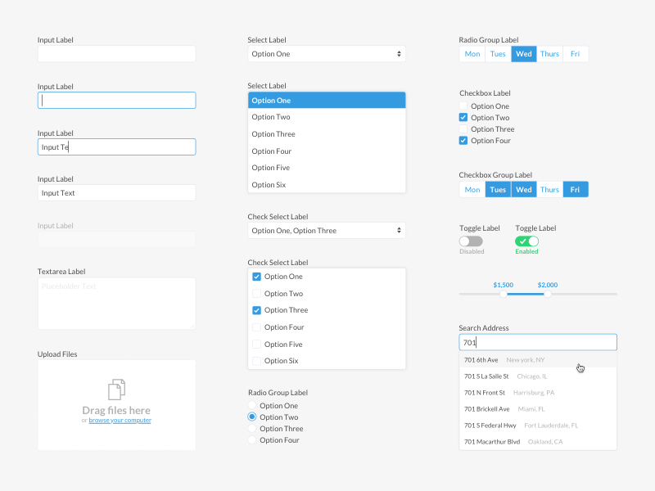


Form Method
Get
Secara default, form memiliki method get. Menambahkan data formulir ke URL dengan pasangan nama & nilai.
Post
Mengirim data formulir sebagai transaksi HTTP.

Slide 6
Form Elements
Input
Text Area
Select
Check Box
Radio
File
Submit

Slide 7
Input
Type
Name
Placeholder
Max
Min
User defined
Maximum of input
Minimum of input
Text for guiding
Class
Id
Style
Type of input
Unique for selector
Unique for selector
Adding style
123456789
abcdefghijklmn
*********
@
https://
07-12-2021
Submit
Reset

Slide 8
Time to Code…

Slide 9




Buy me a coffee?

Slide 10
Thank you

